Slide 1
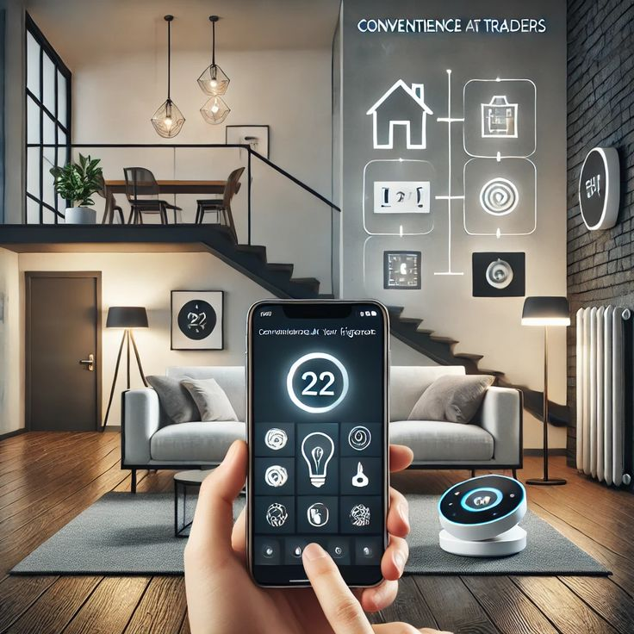

Intelligent Homes
(PCS25-62)
Development of artificial intelligence-based homes automations using IOT and AI bots
By-
Sumit Raj(2100290120167)

Slide 2
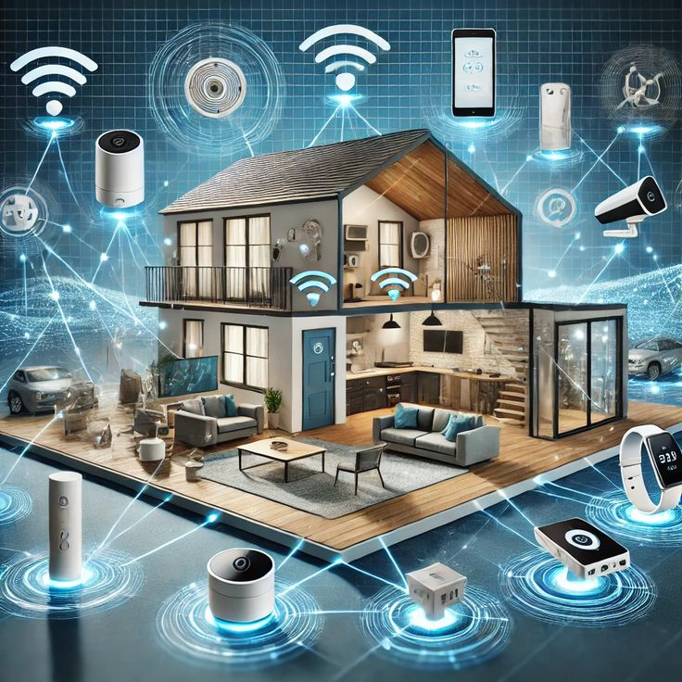
Project Abstract
Intelligent Homes is a smart home system that helps monitor and control household appliances using an easy-to-use digital dashboard.
It uses sensors to detect changes in the environment, such as temperature and sound, and adjusts settings automatically for better comfort and energy savings.
The system learns from daily usage patterns to provide smart suggestions, making home management more efficient and personalized.

Slide 3

Key Objectives
Automated Appliance Control Monitor and control home appliances digitally for improved convenience and energy efficiency.
Smart Environment Detection Use sensors to detect changes in temperature, sound, and other conditions to automatically adjust home settings.
Personalized User Experience Learn user behavior over time to provide smart suggestions and automate routine tasks.
Centralized Home Dashboard Offer a user-friendly dashboard to manage and visualize all smart home activities in one place.

Slide 4
Problem Statement
Manual Control- Traditional system need manual operation, lacking convenience.
No Real-Time Monitoring- Environment changes go unnoticed, causing discomfort.
Energy Wastage – Appliances often left on, leading to higher power bills
Lack of Smart Adaption- No learning from user habits for automatic adjustments.

Slide 5
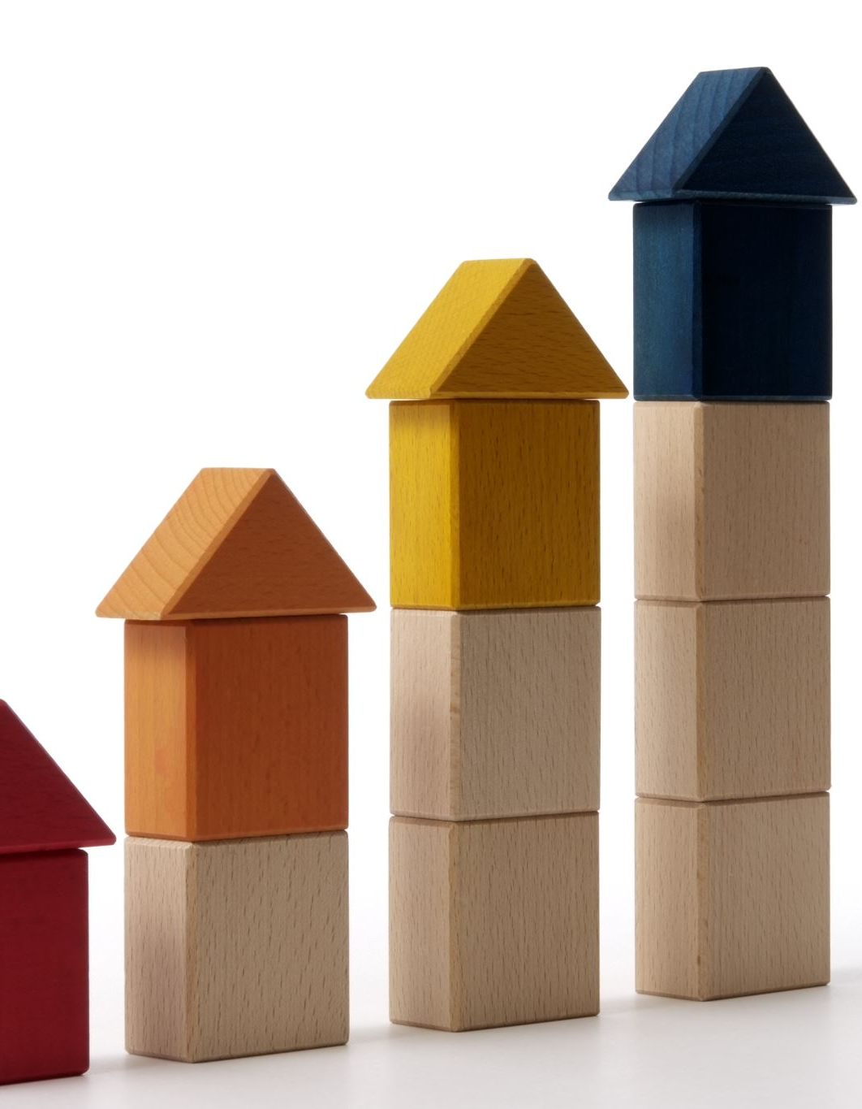
Sustainable Development Goals (SDGs) Alignment
IH aligns with the following Sustainable Development Goals (SDGs):
SDG 9: Industry, Innovation & Infrastructure Implements smart technology and innovative solutions for modern living.
SDG 11: Sustainable Cities & Communities Supports the development of smart, safe, and responsive home environments.
SDG 13: Climate Action Minimizes energy waste, contributing to reduced carbon footprint and environmental sustainability.

Slide 6

Related Work
Traditional home systems offer limited or no automation features.
Manual appliance control lacks efficiency and leads to user inconvenience
Smart home solution often lack adaptive behavior based on user routines.
Many systems are not integrated with centralized dashboards for real-time monitoring and control.

Slide 7

Methodology
Data Collection Environmental data from sensors (temperature, sound, motion) and user interaction patterns.
System Design Centralized dashboard with role-based access for admin and users to monitor and control devices.
Development
Frontend: Interactive web interface
Backend: Server-side logic for device control and data handling
Database: Stores sensor readings and user preferences
Authentication: Secure login system for users.
Functionality Implementation Appliance control, environmental monitoring, smart suggestions based on usage patterns.
Continuous Improvement Designed for easy integration of advanced AI features for predictive automation and energy optimization.

Slide 8
Results & Impact
Minimized the need for manual appliance control and monitoring.
Automatic adjustments improved daily living convenience and comfort.
Optimized appliance usage led to reduced power consumption.
Scalable design ready for integration with advanced AI and IoT features.

Slide 9
Conclusion
Aligns with SDGs to support sustainable living , innovation, and environmental responsibility.
Future expansions will further enhance its smart capabilities and impact on modern, eco-friendly living.
Intelligent Homes successfully automates and enhances key aspects of home management.
It improves comfort, promotes energy efficiency, and adapts to user lifestyles through smart automation.

Slide 10

THANK YOU

